Slide 1
ECE 530 Cloud Computing
Ioannis Papapanagiotou
Microsoft Azure

Slide 2
Microsoft Azure (formerly Windows Azure) is a cloud computing service created by Microsoft for building, testing, deploying, and managing applications and services through Microsoft-managed data centers.
It provides SaaS, PaaS and IaaS and supports many different programming languages, tools and frameworks, including both Microsoft-specific and third-party software and systems.
Azure was announced in October 2008, started with codename "Project Red Dog", and released on February 1, 2010, as "Windows Azure" before being renamed "Microsoft Azure" on March 25, 2014.

Slide 3
Azure Deployment

Slide 4
Azure Deployment
Azure is generally available in 54 regions around the world. Microsoft has announced an additional 12 regions to be opened soon (as of October 2018).
An Azure geography contains multiple Azure Regions,
such as example “North Europe” (Dublin, Ireland), “West Europe” (Amsterdam, Netherlands).
Where a location represents the city or area of the Azure Region. Each Azure Region is paired with another region within the same geography; this makes them a regional pair. In this example, Amsterdam and Dublin are the locations which form the regional-pair.

Slide 5
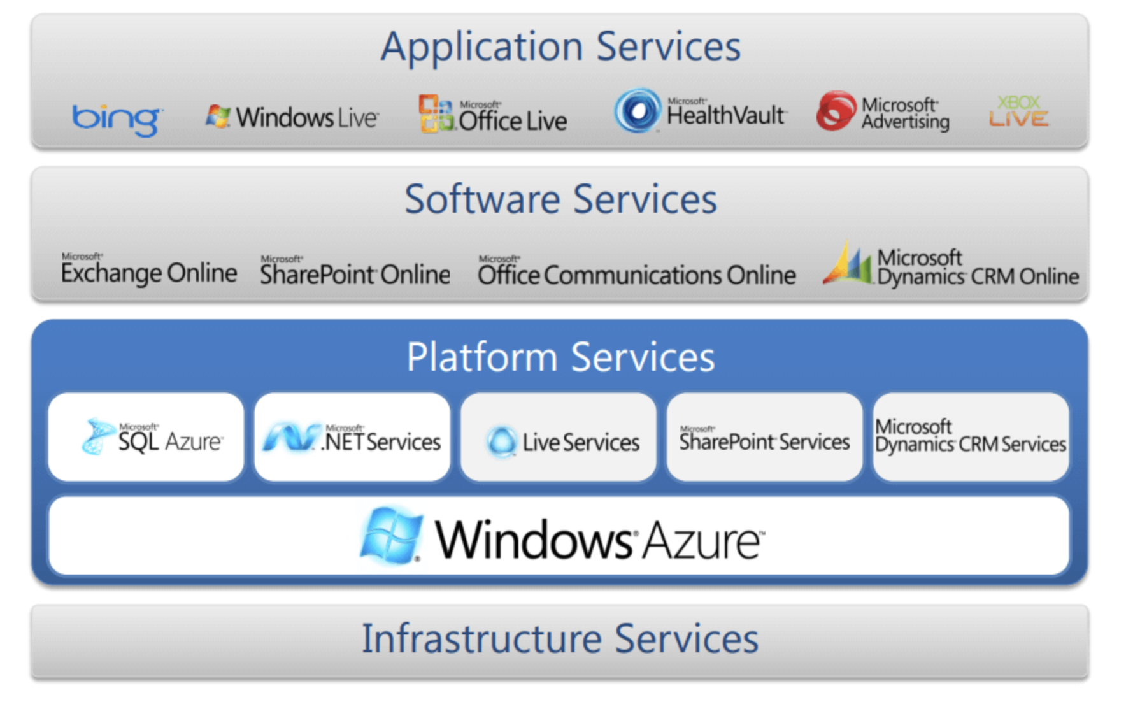
Types of Azure Clouds

Slide 7
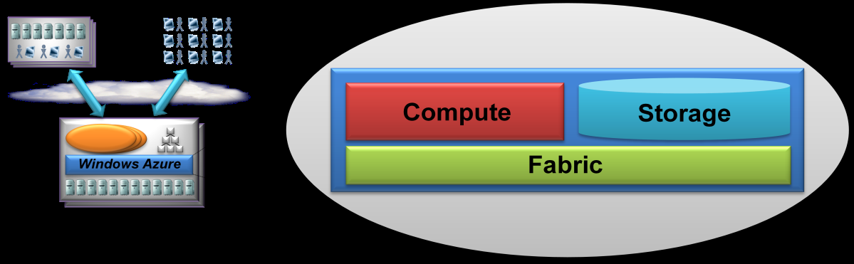
Inside the Azure Layer
Microsoft Azure uses a specialized operating system, called Microsoft Azure, to run its "fabric layer“.
cluster hosted at Microsoft's datacenters that manages computing and storage resources of the computers and provisions the resources (or a subset of them) to applications running on top of Microsoft Azure
Microsoft Azure has been described as a "cloud layer" on top of a number of Windows Server systems, which use Windows Server 2008 and a customized version of Hyper-V, known as the Microsoft Azure Hypervisor to provide virtualization of services
Notes:
Microsoft Azure has been described as a "cloud layer" on top of a number of Windows Server systems, which use Windows Server 2008 and a customized version of Hyper-V, known as the Microsoft Azure Hypervisor to provide virtualization of services.vb Scaling and reliability are controlled by the Microsoft Azure Fabric Controller so the services and environment do not crash if one of the servers crashes within the Microsoft datacenter and provides the management of the user's web application like memory resources and load balancing.

Slide 8
Azure Design
Scaling and reliability are controlled by the Microsoft Azure Fabric Controller, which ensures the services and environment do not fail if one or more of the servers fails within the Microsoft data center, and which also provides the management of the user's Web application such as memory allocation and load balancing.
Azure provides APIs built on REST, HTTP, and XML.
Microsoft also provides a client-side managed class library that encapsulates the functions of interacting with the services.

Slide 9
Benefits of Azure
One of the core strengths of Microsoft Azure is the ease of transition for organizations looking to migrate from other Microsoft products, such as SharePoint, or integrate tightly with an existing Windows deployment.
The task of administering certain technologies such as Windows Server, Active Directory, and SharePoint can be greatly eased with the combination of Azure and Office 365.
This frees up IT staff to work on new projects, rather than spending time on general system upkeep.

Slide 10
Overall Comparison
Amazon Web Services, much like Amazon itself, aims to be everything to everyone; as such, AWS has the most extensive portfolio of cloud services of any public cloud provider.
Google Cloud Platform's core strengths are in machine learning, big data tools, and extensive container support.

Slide 11
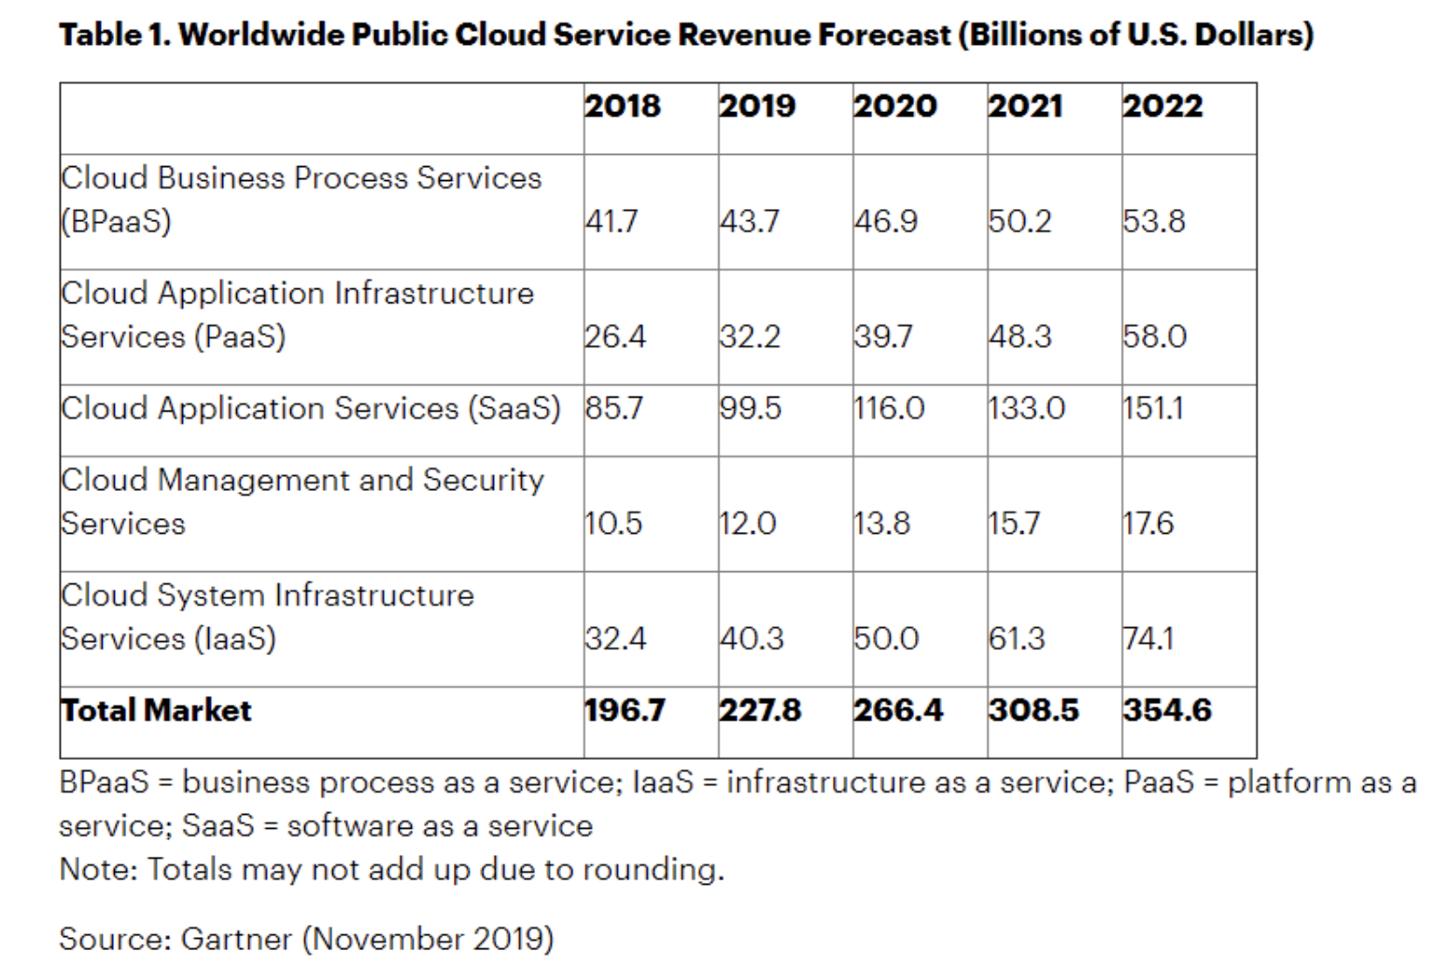
Overall Cloud Revenue

Slide 12
How big is Azure
There is still no publicly available data on Azure sales.
Azure is the part of Microsoft's cloud business that most rhymes with AWS, but is buried in the commercial cloud.
Commercial cloud is a roll-up of multiple services from Microsoft.
Enterprises are likely to buy a buffet that includes Azure but isn't totally focused on it. That said, Microsoft's commercial cloud is on a $50 billion annual revenue run rate.
Microsoft Azure benefits from its software-as-a-service footprint.
The reality is that we could easily take Microsoft out of the IaaS category and put it in the SaaS section since most of the revenue is derived from Office 365, Dynamics and a bevy of other cloud services that are software-based over infrastructure.
While Amazon specifies AWS revenue, Microsoft only reports on Azure’s growth rate. That number is 62% revenue growth in Q4/2019 over the previous quarter. Tin Q4/2018, the growth was reported at 76%.

